Slide 1


Customer Segmentation Using R
Presented by
Mohammadshoaib Nadaf (1328)
Shruti Thorat(1347)
Akshay Tilekar (External Guide)
Prashant Karhale Rahul Pund (Internal Guide)
Center Coordinator Tejal Mehetre (Internal Guide)

Slide 2
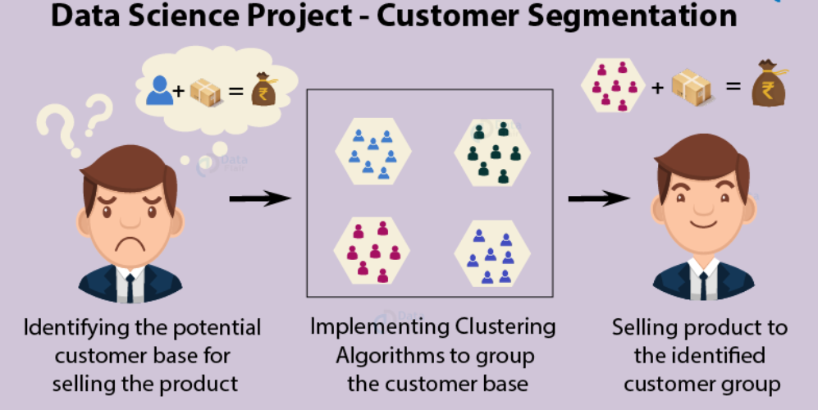
Introduction
Customer Segmentation is one the most important applications of unsupervised learning. Using clustering techniques, companies can identify the several segments of customers allowing them to target the potential user base.

Slide 3
What is Customer Segmentation?
Customer Segmentation is the process of division of customer base into several groups of individuals that share a similarity in different ways that are relevant to marketing such as gender, age, interests, and miscellaneous spending habits.
Companies that deploy customer segmentation are under the notion that every customer has different requirements and require a specific marketing effort to address them appropriately.
Companies aim to gain a deeper approach of the customer they are targeting. Therefore, their aim has to be specific and should be tailored to address the requirements of each and every individual customer.

Slide 4
Three most common types of Customer Segmentation
1. Demographic Segmentation
The parameters such as age, gender, education, income, financial status, etc. come under the demographics of a person. This kind of segmentation is the most common approach to segment customers since this data is easy to obtain and analyze.
2. Geographic Segmentation
As the name suggests, this kind of customer segmentation is done based on the physical location of a person. An example, in this case, would be a company which manufactures air conditioning systems. It cannot offer the same products to people in India and Iceland.
3. Behavioral Segmentation
This kind of customer segmentation is based on the behavioural data of the customers. The grouping is done based on the purchasing habits, spending habits, brand interactions, browsing history or any other data which corresponds to behavior or a person.

Slide 5
Problem Statement
The problem statement is formulated as “Given the demographic data of a person, how can a mail-order company efficiently acquire new customers”.

Slide 6
Customer Segmentation using RFM Analysis
RFM (recency, frequency, monetary) analysis is a marketing technique used to determine quantitatively which customers are the best ones by examining
how recently a customer has purchased (recency),?
How often they purchase (frequency)?
How much the customer spends (monetary)?

Slide 7
Data Information :
transnational data set which contains all the transactions occurring between 01/12/2010 and 09/12/2011 for a UK-based and registered non-store online retail. The company mainly sells unique all-occasion gifts. Many customers of the company are wholesalers.
The costumers are from 37 different countries.

Slide 8
Description :
Name | Description
Invoice No | a 6-digit integral number uniquely assigned to each transaction. If this code starts with letter 'c', it indicates a cancellation
Stock/Product No | a 5-digit integral number uniquely assigned to each distinct product
Quantity | The quantities of each product (item) per transaction. Numeric.
Invoice Date | Numeric, the day and time when each transaction was generated.
Unit Price | Product price per unit in sterling.
Customer ID | a 5-digit integral number uniquely assigned to each customer.
Country | the name of the country where each customer resides.

Slide 9
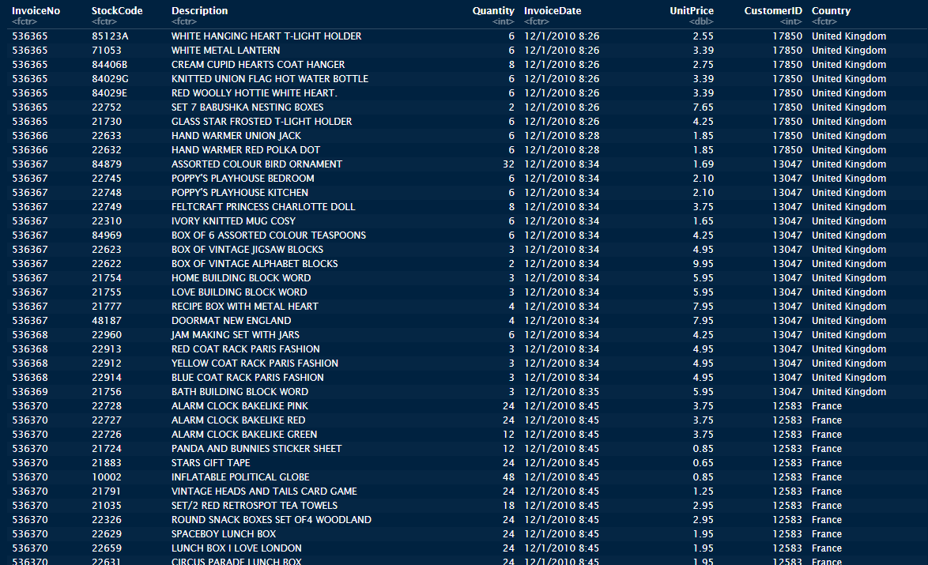

Slide 10
Exploratory Data Analysis

Slide 11
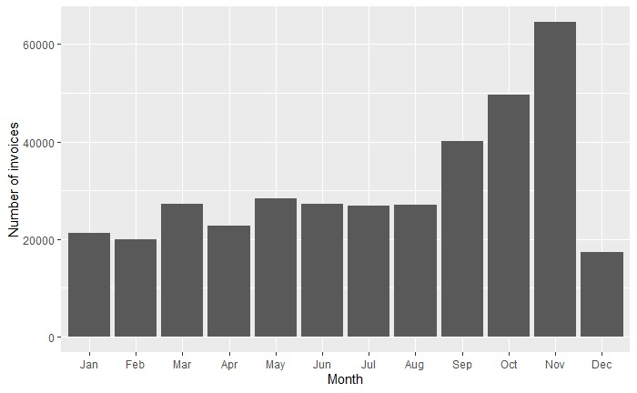
Number of invoice per Month:
It seems that the number of transactions is rising from September and the highest in November. In December the lowest number of transactions is performed.

Slide 12
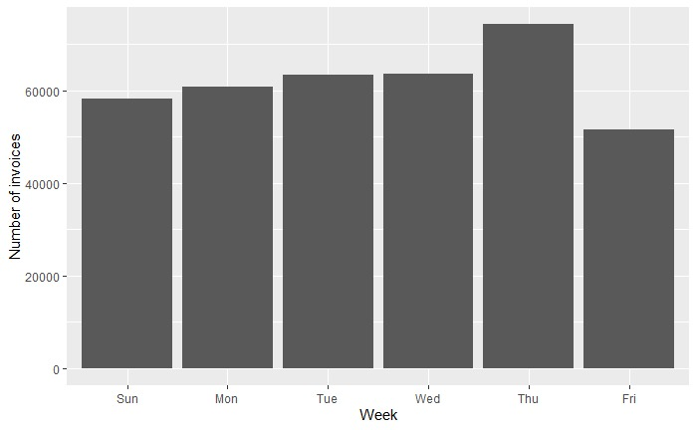
Number of invoice per Week:
Most transactions are placed on Monday, Tuesday, Wednesday and Thursday.

Slide 13
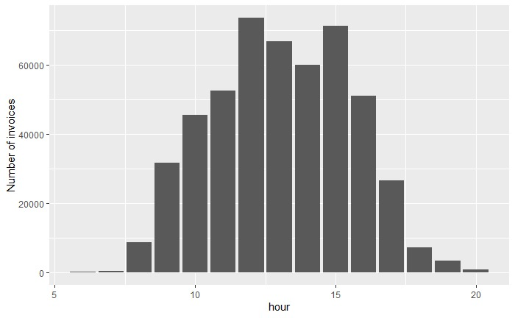
Number of invoice per hour:

Slide 14
RFM
Recency was calculated as one of the features for the segmentation analysis. In this case recency has been calculated as follows, time of customer’s last purchase minus Latest date
Frequency was calculated counting the number of times a customer has made a transaction with the Online Retailer in a year.
Monetary Value refers to the total sum of revenue generated by the user over the course of a year.
Recency, Frequency and Monetary Value of each customer. The three of these variables are now linked to the respective CustomerID.

Slide 15
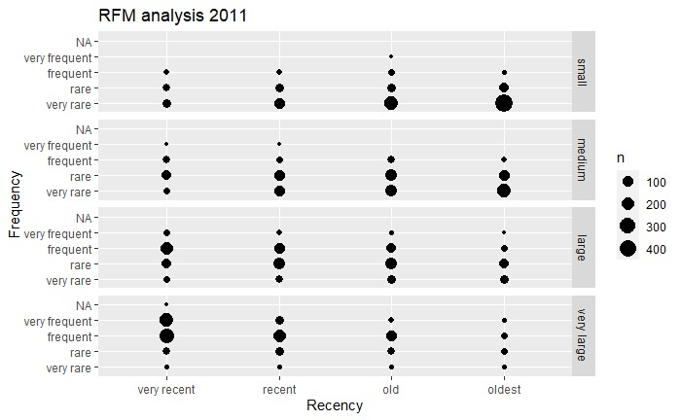
We now have segmented our customers in different groups

Slide 16
Clustering (K-means)
K-means is one of the simplest unsupervised learning algorithms that solve the well known clustering problem.
The procedure follows a simple and easy way to classify a given data set through a certain number of clusters
The algorithm will categorize the items into k groups of similarity.
The K-means clustering algorithm is used to find groups which have not been explicitly labeled in the data. This can be used to confirm business assumptions about what types of groups exist or to identify unknown groups in complex data sets

Slide 17
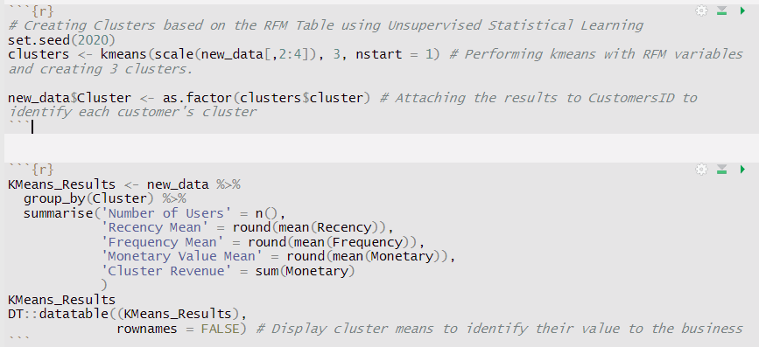
Implementation
Cluster | Number of Users | Recency Mean | Frequency Mean | Monetary Value Mean | Cluster Revenue
1 | 8 | 24 | 113 | 4025 | 32201
2 | 1112 | 267 | 2 | 28 | 30890
3 | 3219 | 63 | 5 | 104 | 334793

Slide 18
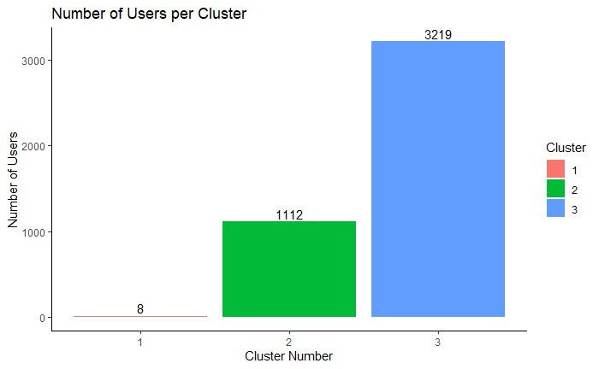
Result
High Value Customers - Cluster 1
8 customers
Avg 24 days of inactivity.
Avg number of Purchases, 113 a year.
Avg Monetary Revenue of $4025 a year.
Medium Value Customers - Cluster 3
3219 customers.
Avg 63 days of inactivity
Avg Number of Purchases, 5 a year
Avg Revenue of $104 a year
Low Value Customers - Cluster 2
1112 customers.
Avg 267 days of inactivity
Avg Number of Purchases, 2
Avg Revenue of $28 a year

Slide 19
Conclusion :
K means clustering is one of the most popular clustering algorithms and usually the first thing practitioners apply when solving clustering tasks to get an idea of the structure of the dataset.
The goal of K means is to group data points into distinct non-overlapping subgroups. One of the major application of K means clustering is segmentation of customers to get a better understanding of them which in turn could be used to increase the revenue of the company.

Slide 20
Thank You

